Slide 1
Fundamentals of Computing Programing Structures

Slide 2
Session 6: Fundamentals of Computing
Table of Contents
Programming concepts
Introduction
Program Structure
Variable Declaration
The Boolean Operators
Comparison Operators
Combining Boolean and Comparison Operators
Conditional Statements (IF..THEN..ELSE)
Iterative Constructs (Loops)

Slide 3
Introductions
Computer programs are collections of instructions that tell a computer how to interact with the user, interact with the computer hardware and process data.
Low Level Language-Machine Language
High Level Language-Ex. C,C++,Java
Compiler- A Software that is used to translate high level instruction into machine language.

Slide 4
Compiled Language Vs Interpreted Language
Higher level languages such as “C”, C++, Pascal, Cobol, Fortran, ADA and Java are called “compiled languages”. In a compiled language, the programmer writes more general instructions and a compiler automatically translates these high level instructions into machine language. The machine language is then executed by the computer.
In an interpreted programming language, the statements that the programmer writes are interpreted as the program is running. This means they are translated into machine language on the fly and then execute as the program is running. Some popular interpreted languages include Basic, Visual Basic, Perl, Python, and shell scripting languages such as those found in the UNIX, Linux and MacOS X environment.

Slide 5
Programing Concepts Examples
Computer Programing Languages can be classed into three (3) different categories of computer languages: Machine language, Assemble language and High-Level language
Machine Language
Native language of a particular computer
Instructions are in Binary form ( 1s and 0s)
All language are translated to machine language
Example:
X = X + 1 mathematical notation
1010 0001 1110 0110 0000 0001
0000 0011 0000 0110 0000 0001 0000 binary notation
0000 1010 0011 1110 0110 0000 0001

Slide 6
Programing Concepts (cont…)
Assembly Language
uses English-like abbreviations to represent operations performed on the data.
must be translated into machine language with the help of the special program called an assembler.
Example:
MOV AX, [01E6]
ADD AX, 0001
MOV [01E6], AX
increasing the value of the variable by 1 as well. This example is also specific to an Intel processor.

Slide 7
Programing Concepts (cont…)
High-Level Language
uses English-like instructions and common mathematical notations.
allow programmers to perform complicated calculations with a single instruction
easier to read and understand than machine and assembly languages
not as time-consuming to create a program in high-level language as it is in machine or assembly language
Example:
variable := variable + 1;

Slide 8
Introduction
Computer Programs (softwares) and Languages:
set of instruction executed by a computer to perform a task
non physical part of the computer but very important
There are different types of programs developed from different types of computer language
Two different types of Softwares:
System software
Application Software
Softwares are developed from different languages

Slide 9
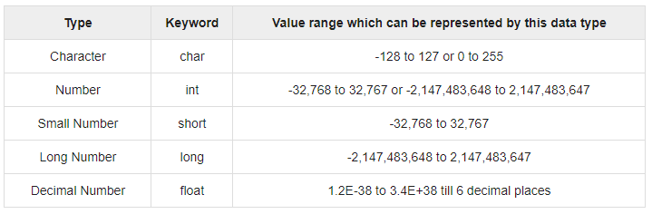
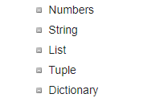
Program Structure
Definition:
A collection of different datatypes, variables, grouped together under a single name.
Examples of Different datatypes:
C, C++, Java datatypes Python Datatypes

Slide 10
Structured Programming Vs Object Oriented Programming
In structured programming, blocks of programming statements (code) are executed one after another. Control statements change which blocks of code are executed next.
In object oriented programming, data are contained in objects and are accessed using special methods (blocks of code) specific to the type of object. There is no single “flow” of the program as objects can freely interact with one another by passing messages.

Slide 11
Program Structure
The same structure is followed by all structured programs :
Statement to establish the start of the program
Variable Declaration
Program Statements(blocks of code)

Slide 12
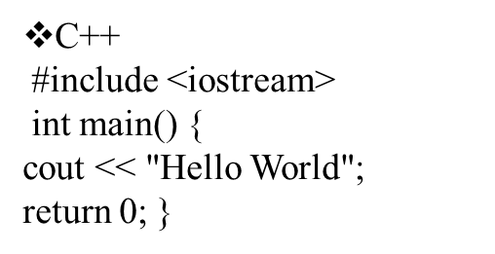
Examples
C
#include <stdio.h>
void main() {
printf("Hello World");
}
Java
class helloworld { public static void main (String args [])
{ System.out.println ("Hello World"); } }
Basic
print "Hello World"

Slide 13
Variable Declaration
Variables are place holders for data a program might use or manipulate.
Variables typically store values of a given type. Types generally include:
Integer – to store integer or “whole” numbers
Real – to store real or fractional numbers (also called float to indicate a floating point number)
Character – A single character such as a letter of the alphabet or punctuation.
String – A collection of characters

Slide 14
Examples
C #include <stdio.h> void main() { int age; float salary; char middle_initial; age = 21; salary = 29521.12; printf("I am %d years old ", age); printf("I make %8.2f per year " salary); } | Java class myexample { public static void main (String args []) { int age; double salary; age = 21; salary = 29521.12; System.out.println ("I am " + age + " years old "); System.out.println ("I make " + salary + " per year"); }

Slide 15
Boolean Logic and Boolean Algebra
Boolean Algebra was invented by nineteenth century mathematician George Boole.
Only two answers are possible for Boolean Algebra : True or False.
Boolean logic is called a Two Valued Logic because an expression may only take on one of two values: True or False.
An expression is some collection of logical operands and logical operators that are combined together.

Slide 16
Continue…
In Arithmetic,
Operands: Numbers
Operators: Addition, Subtraction, Multiplication and Division
In Boolean Logic,
Operands: Statements
Operators: Logical AND , OR and NOT

Slide 17
Boolean Operator
There are three Boolean Operators : AND , OR and NOT. These operators are written differently depending on the language being used.
Language | AND | OR | NOT
C or C++ | && | || | !
Java | & | || | !
Basic | AND | OR | NOT

Slide 18
Continue…
The Boolean operators are evaluated in the following fashion.
For the AND operator, the combination of two “True” values results in “True” all other combinations evaluate to False.
For the OR operator, as long as one of the value is True, then the expression evaluates to True.
The NOT operator is called the “complimentary” operator. It reverses the truth value of the operand.

Slide 19
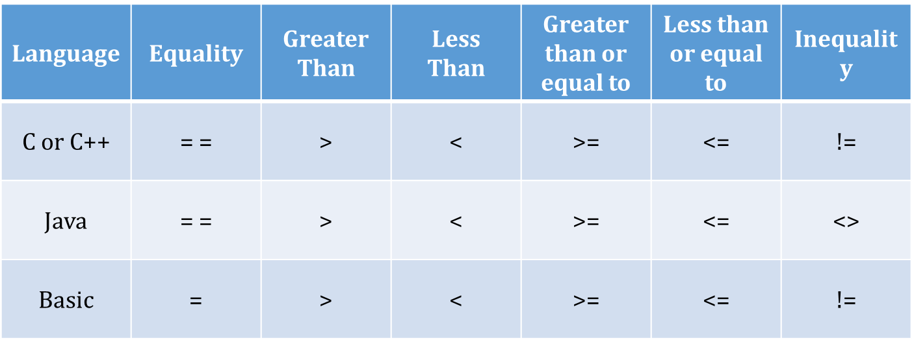
Comparison Operators
Boolean expressions often involve comparison operators that can be evaluated to determine if they are True or False.
Comparison Operators include:
= , < , > ,>= , <= , !=

Slide 20
Combining Boolean and Comparison Operators
All employees belong to a department
All employees working in department 5 have salaries greater than $25,000
All employees in department 4 make exactly $40,000 per year.
Alice is an employee and she works in department 5
Bill is an employee and he works in department 4
Expressions
Alice_salary < 25000 OR Alice_Department = 4
Alice_salary >= 25000 AND Bill_department = 4
Alice_salary < 25000 OR Bill_Salary < 40000 OR Alice_Department = 5

Slide 21
Conditional Statements(If..Then..Else)
Control statements “control” which sections of code in a program will be executed.
There are 3 types of Control Statements:
Sequential – The default ordering of execution
Decision (Conditional) – controls which block of code within several alternatives is executed.
Iterative – controls how many times a block of code is executed.

Slide 22
Example for Control Statements
Language | Example Program
“C” or C++ | #include <stdio.h> main() { int department; department = 5; if (department == 5) { printf("Employees should be paid more than 25,000"); } else { printf("Employees should be paid exactly 40,000"); } }
Java | class myexample { public static void main (String args []) { int department = 5; if (department == 5) { System.out.println ("Employees should be paid more than 25,000"); } else { System.out.println ("Employees should be paid exactly 40,000"); } } }

Slide 23
Iterative Constructs (Loops)
All programming languages have a facility to allow a section of code to be repeated (iterated or looped).
Looping Constructs fall into two categories: FOR loops and WHILE/DO loops.

Slide 24
FOR Loops
Simple FOR loops iterate a specific number of times based on counting up (or down) on an integer variable. For example, if we want to do something 10 times, we can make a loop that counts up from 1 to 10 and put our code inside the loop.
The three main parts that need to be written for a FOR loop are :
Initialization (the initial or starting value)
Condition (the condition under which the loop will stop)
increment (or decrement).

Slide 25
WHILE and DO Loops
Like FOR loops, the WHILE and DO loops are also used to repeat a section of code for some number of times. However while FOR loops basically specify some count, WHILE and DO loops repeat while a condition is true.
The condition is a boolean expression that we can evaluate as either "true" or "false". As soon as the condition evaluates to "false" the loop ends.
The main difference between a WHILE loop and a DO loop is where the condition is checked. WHILE loops check the condition first, and then run the statements if true. DO loops run the statements first, then check if the condition is true.

